Slide 1
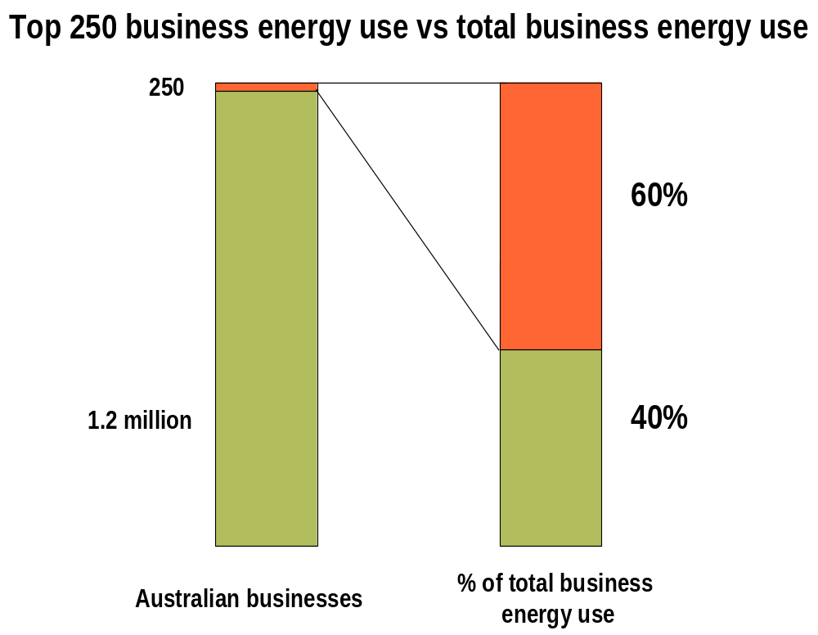
Overview of EEO
Notes:
Legislation passed in 2006
Aimed at the top 250 companies in Australia, who account for 60% of business energy consumption
Threshold was set at 0.5 PJ at a corporate level

Slide 2


- Australian Government - Department of Industry, Tourism & Resources
The Commonwealth Government has developed an extensive set of Guidelines that describe in detail the requirements of the EEO Program.
The key element that guides the needs of your business in relation to EEO is the “Assessment Framework” from the Guidelines.
As a guide to businesses, those using more than 0.5 petajoules (PJ) a year may typically have an annual energy bill of more than $1.5 million for gas, $5 million for electricity, $11 million for diesel fuel or $13 million for unleaded petrol (depending on prices). Put another way, 0.5 PJ approximately equals 139,000 MWh, 13 ML diesel, 9000 tonnes of LNG or 10,000 tonnes of LPG .

Slide 3
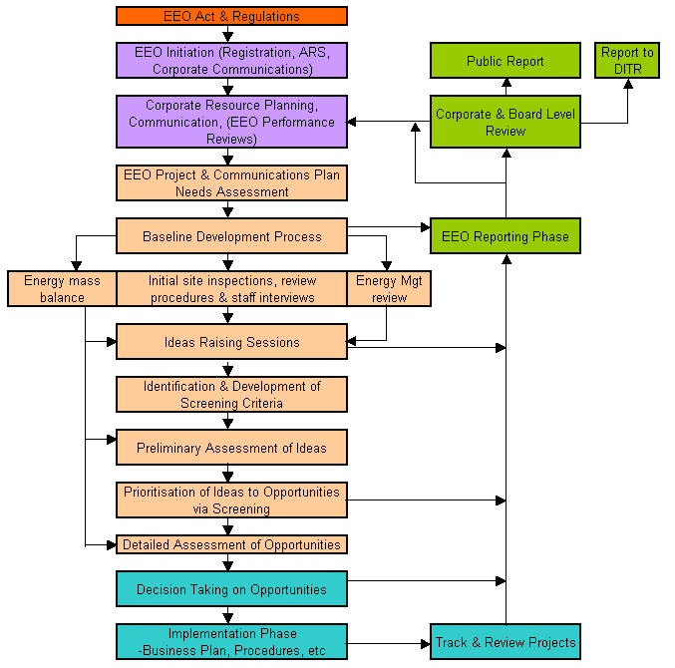
This process we propose to meet your needs is illustrated below, and is consistent with the requirements of EEO site assessments

Slide 4
The Commonwealth Government has developed an extensive set of Guidelines that describe in detail the requirements of the EEO Program.
The key element that guides the needs of your business in relation to EEO is the “Assessment Framework” from the Guidelines.

Slide 5
In relation to this framework, the EEO Guidelines outline an evidence-based approach and processes to meeting the requirements, and an over-arching focus on the management systems underpinning energy throughout your corporation. Specifically:
Leadership – Demonstrated commitment through all levels of the corporation.
People – Who is involved, when, how is this resourced?
Information, data and analysis – Sufficient information to support a business decision, as well as reporting of outcomes.
Opportunities Identification and Evaluation – How have these been raised, how broad was the assessment?
Decision Making – Who took decisions, when, how, why?
Communicating Outcomes – Inter and intra corporation, public communication.

Slide 6
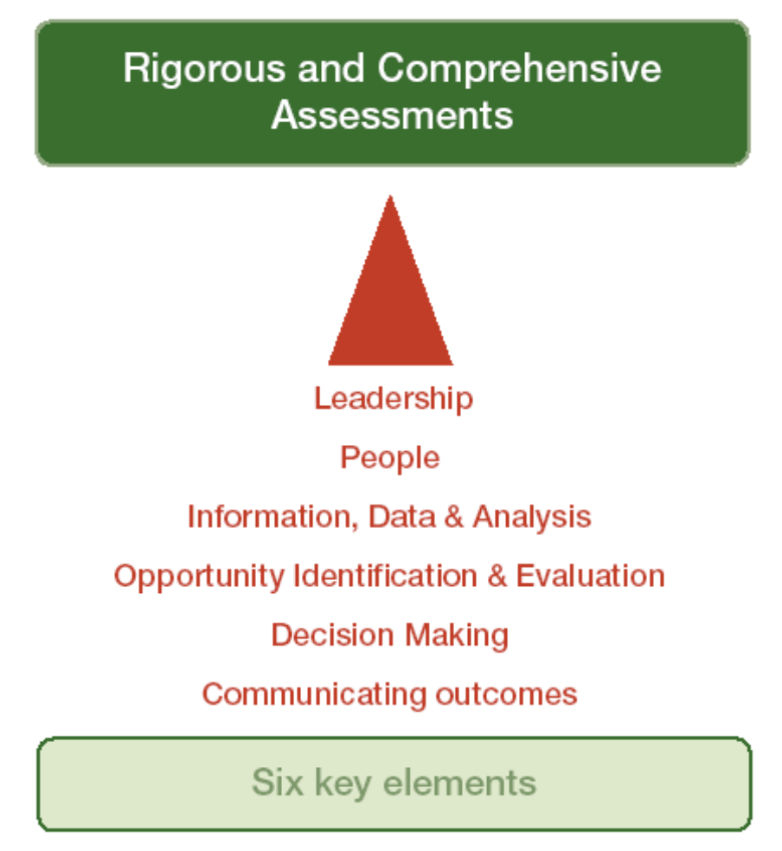

Slide 7
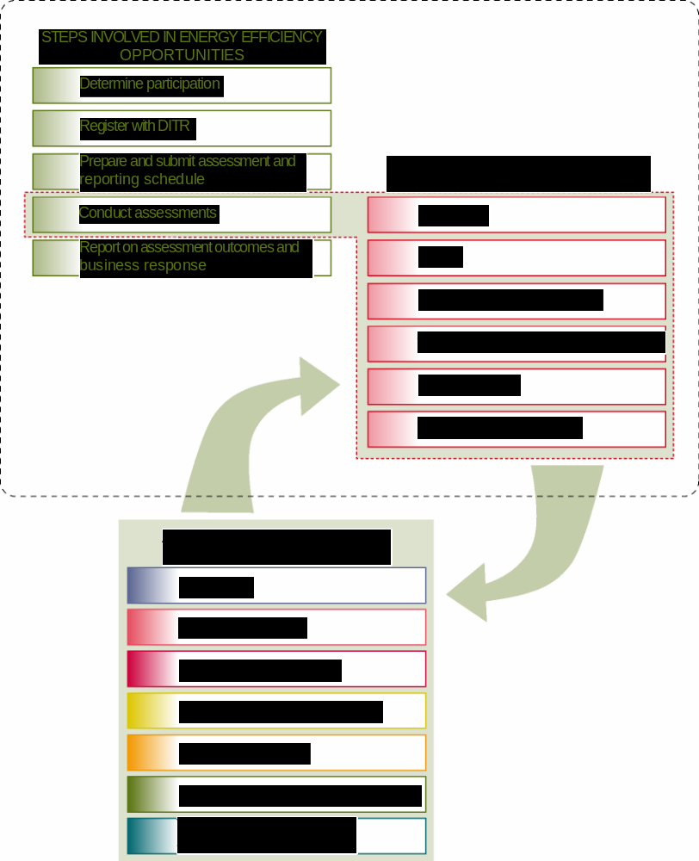
Overview of the Assessment Process & Context

Slide 8
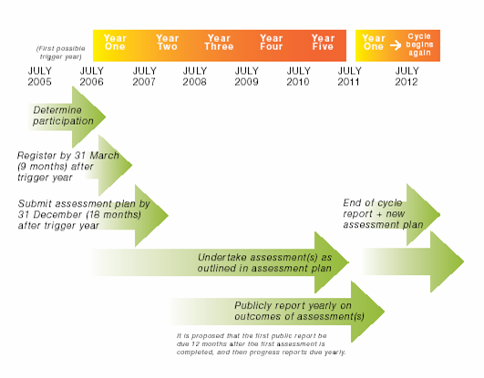
Overview of EEO

Slide 9
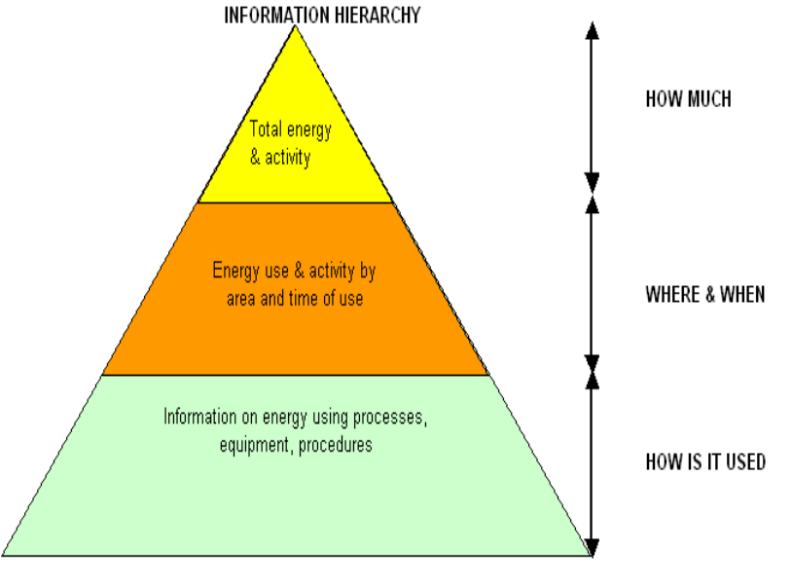
Baseline Development Overview
The baseline development process involves three discrete stages of work, including:
Initial comprehensive site inspections, review of procedures & staff interviews, technologies employed, controls, information systems,
Development of an energy use baseline and energy mass balance, drawing on energy & process data, and
Energy management systems review

Slide 10
Energy Efficiency Opportunities program requirements
The Energy Efficiency Opportunities program requires that participants quantify current and historical energy consumption. This must incorporate 24 months of energy and production data to ±5% accuracy, as stipulated in the Energy Efficiency Opportunities Industry Guidelines (Key Element
3, Page 44).
This 24 month time frame exists because baseline profiles must incorporate the variations of seasonal, monthly and annual production and weather cycles.
Production data for the same time period and frequencies must also be captured.
When establishing a baseline for an individual process, all processes that consume at least 0.1 PJ per annum of energy should be ‘tracked separately’ to allow inclusion in the Energy Mass Balance.
This also involves capturing 24 months of energy data for all energy sources to an accuracy of ±5% as well as 24 months of production data with the same timing and frequency as the energy data.

Slide 11
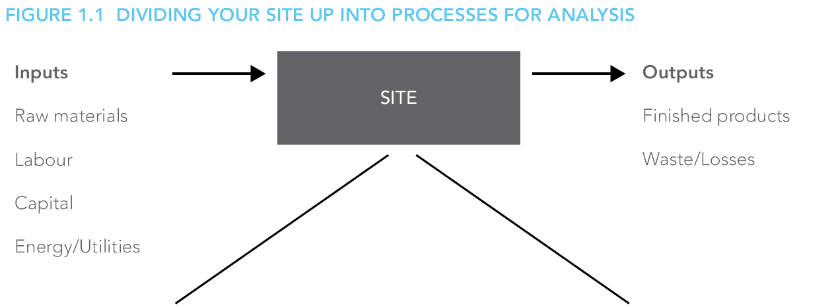
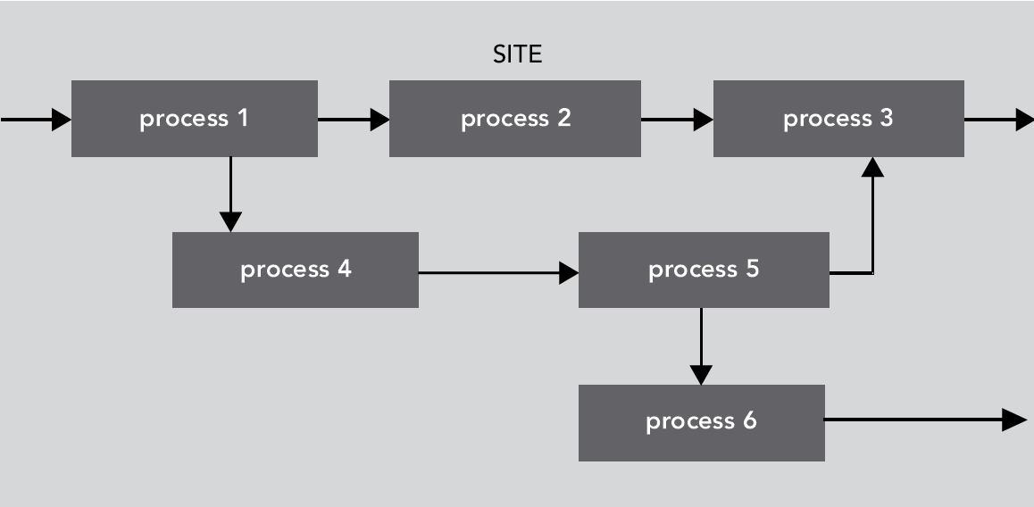

Slide 12
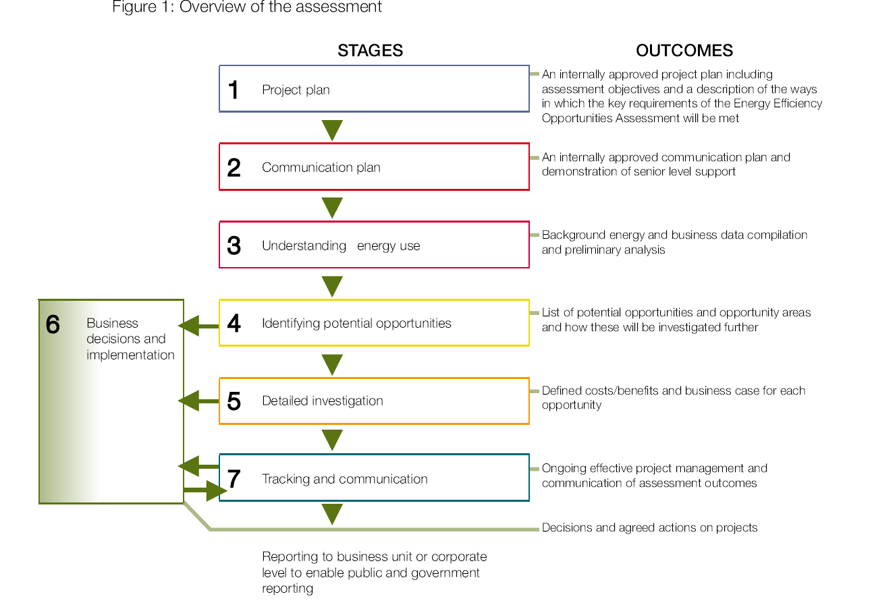

Slide 13
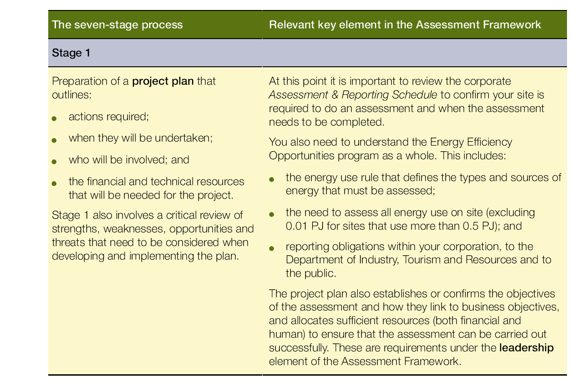

Slide 14
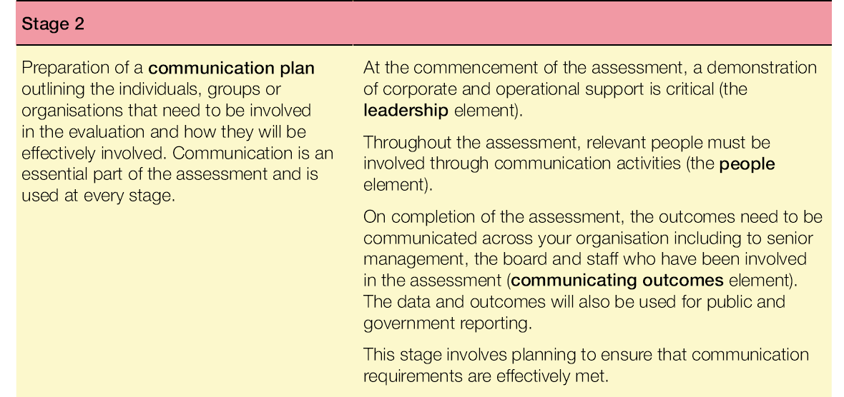

Slide 15
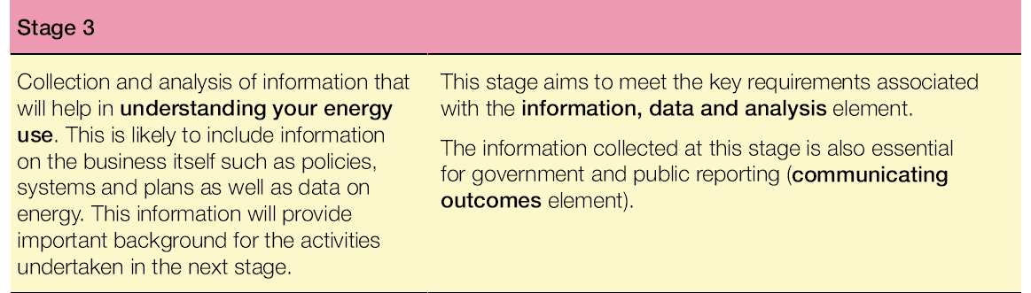

Slide 16
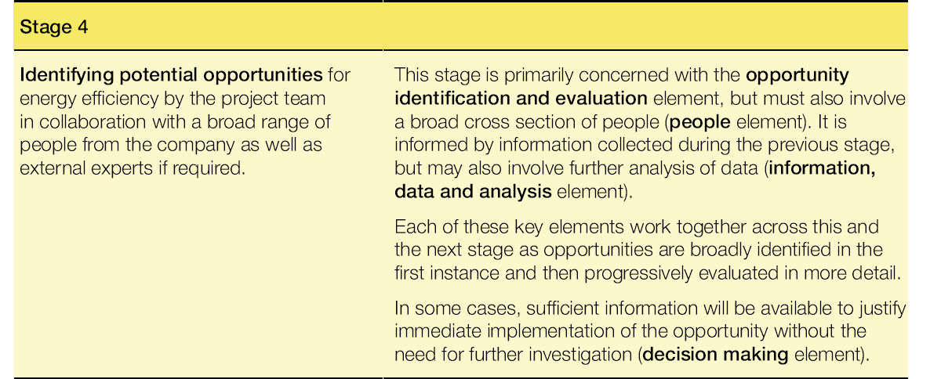

Slide 17
Ideally the balance includes all of the individual processes that make up the whole energy-using process for a site or fleet. You must define to ±5% accuracy a minimum of 80% of the site’s energy use and all processes that use more than 0.1 PJ.
Note that the Energy Efficiency Opportunities program requires sites over 0.5 PJ to assess opportunities across all energy use except for minor activities totaling up to 0.01 PJ.
This guidance regarding application of energy-mass balances is intended to encourage program participants to apply them where they are of most value to them in identifying opportunities.

Slide 18
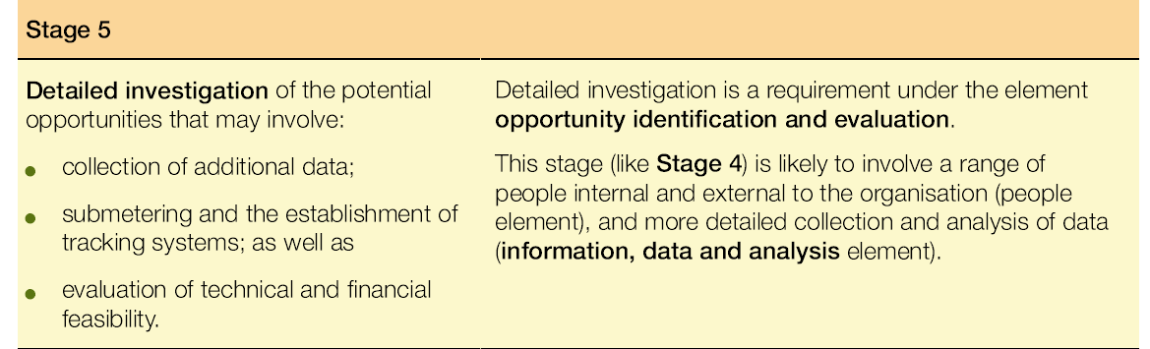

Slide 19
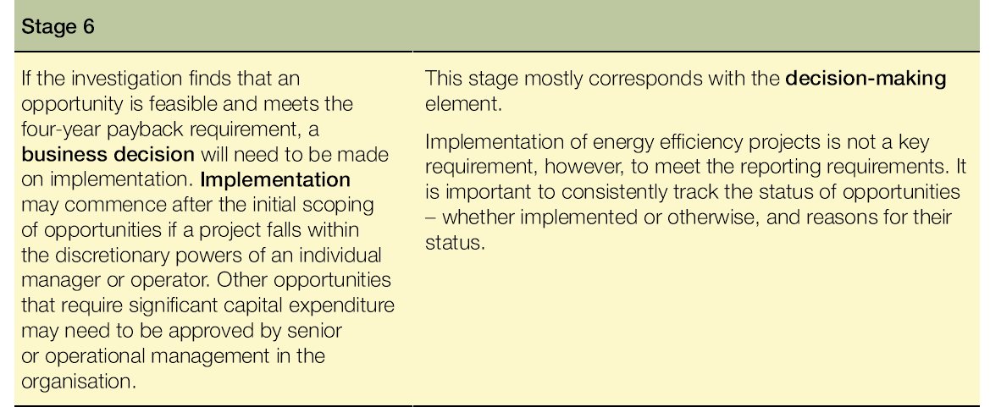

Slide 20
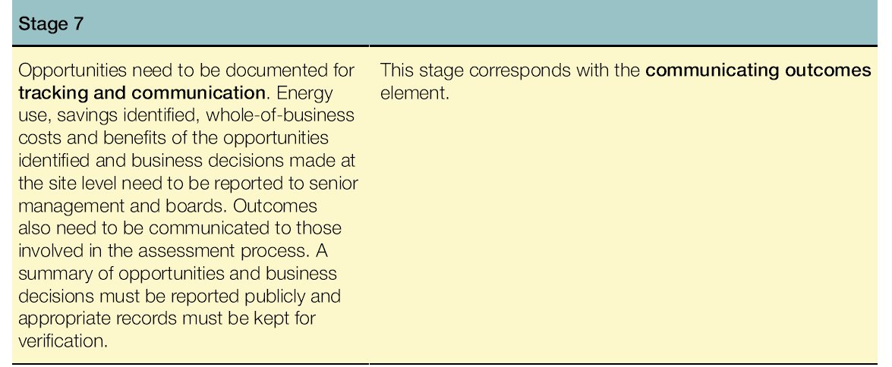

Slide 21
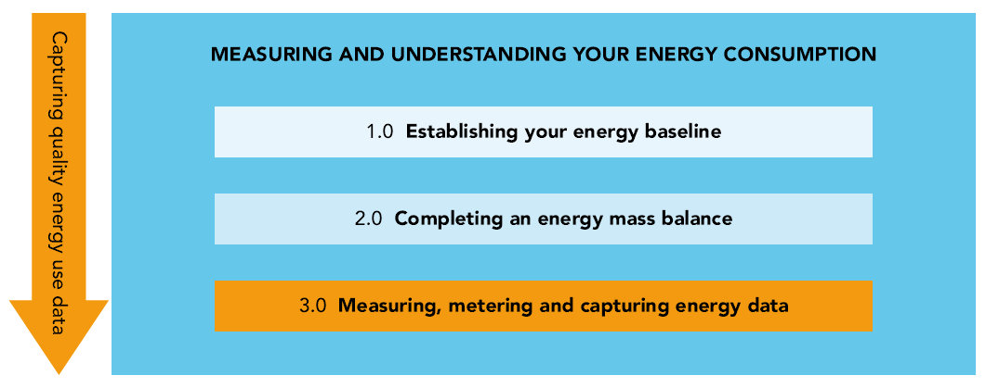

Slide 22
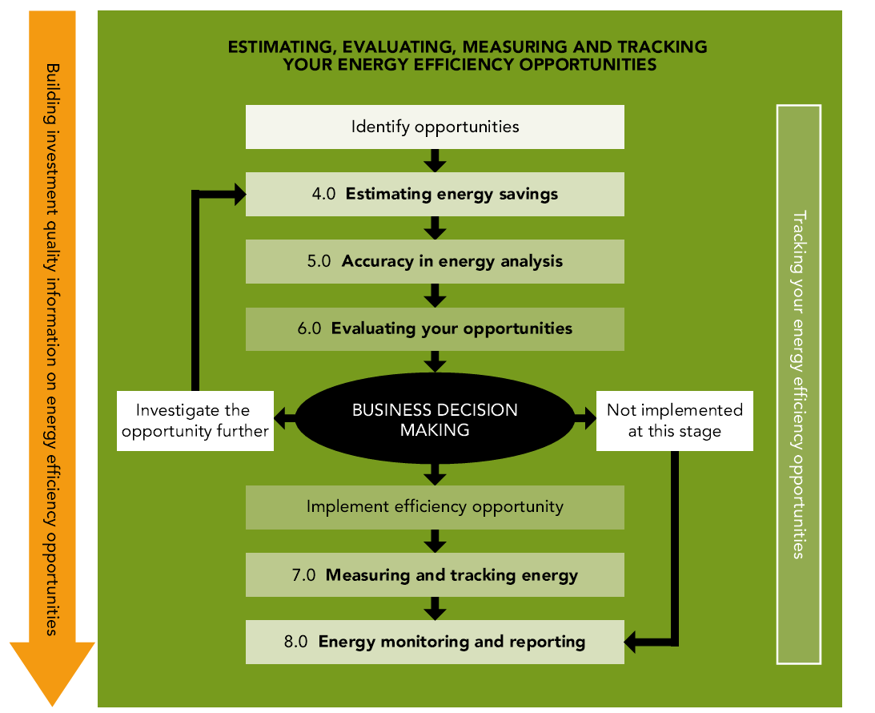

Slide 23
